Slide 1
Pigtail Adapter
Documentation v0
John Hermiz
11/7/16

Slide 2
Overview
This document describes how to use, take apart and assemble the pigtail adapter

Slide 3
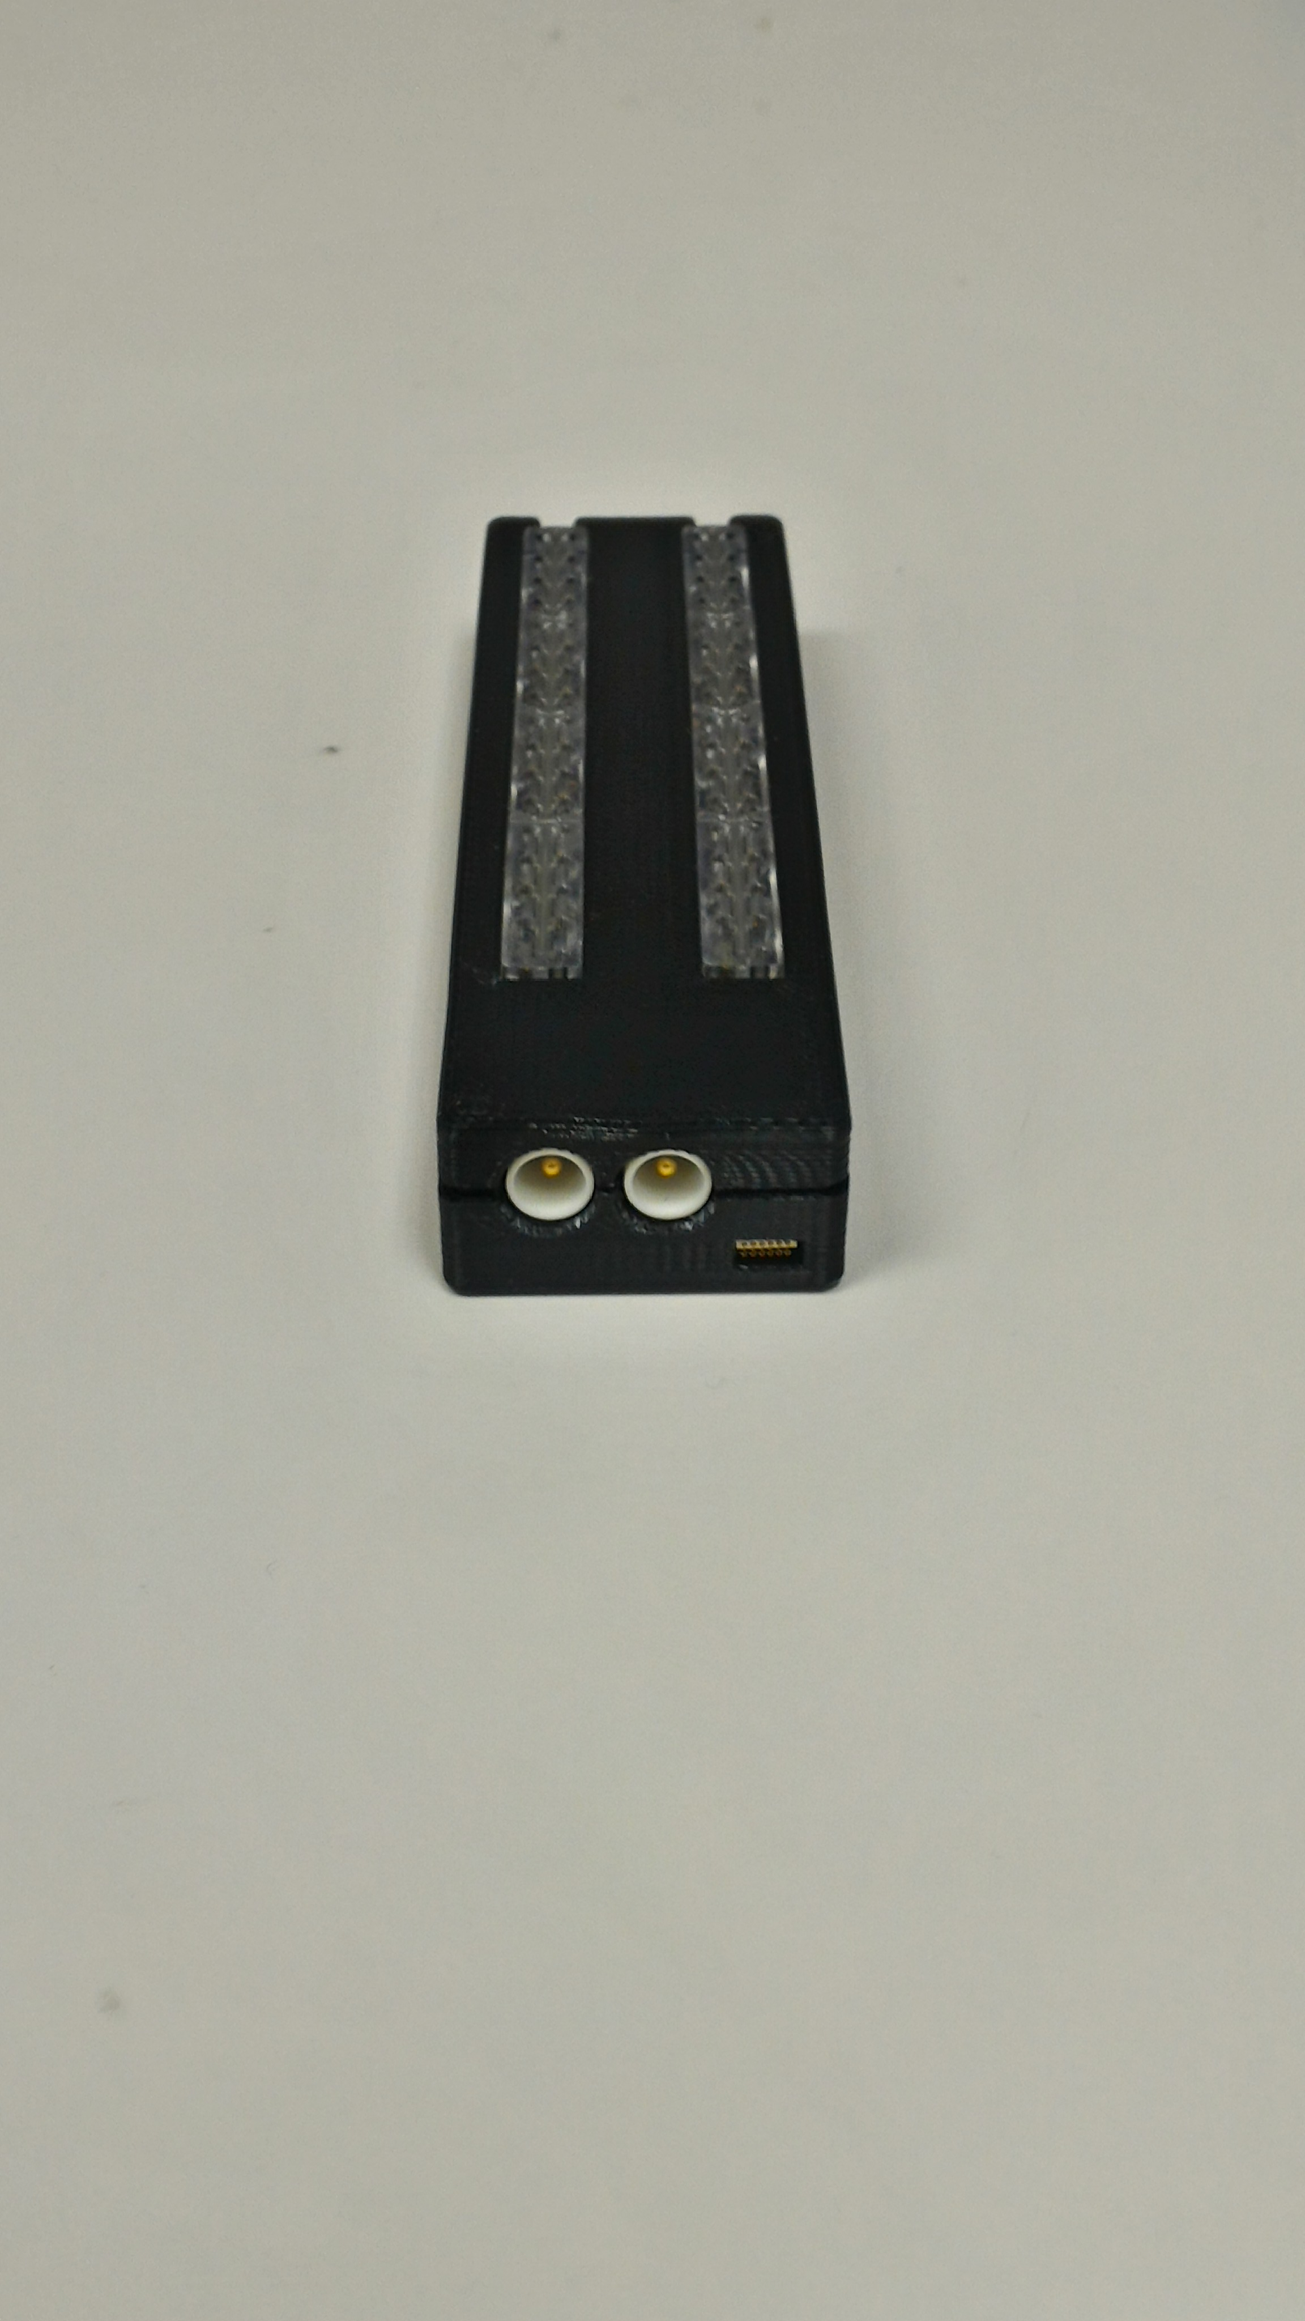
Pigtail Connector
Intan Connector
GND
REF

Slide 4
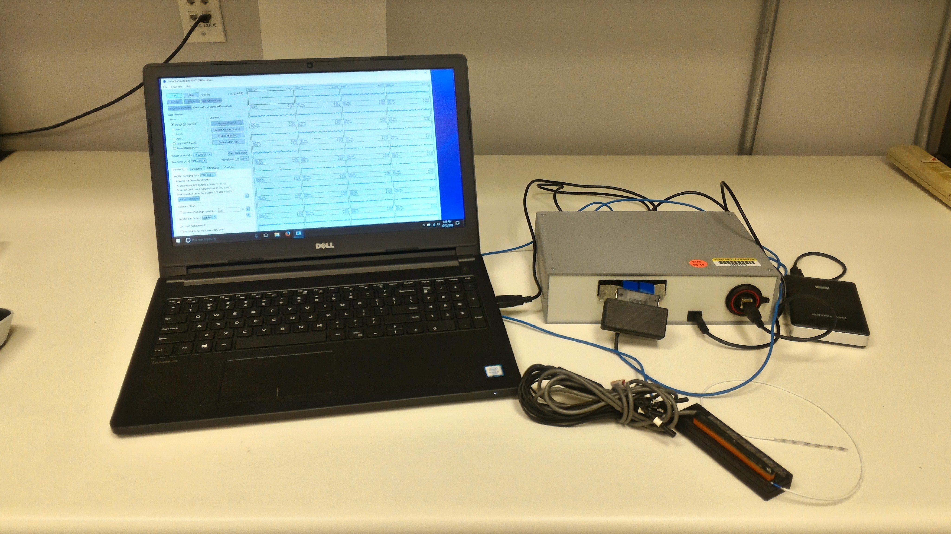
How to Setup
Pigtail Adapter
This is how the final setup looks

Slide 5
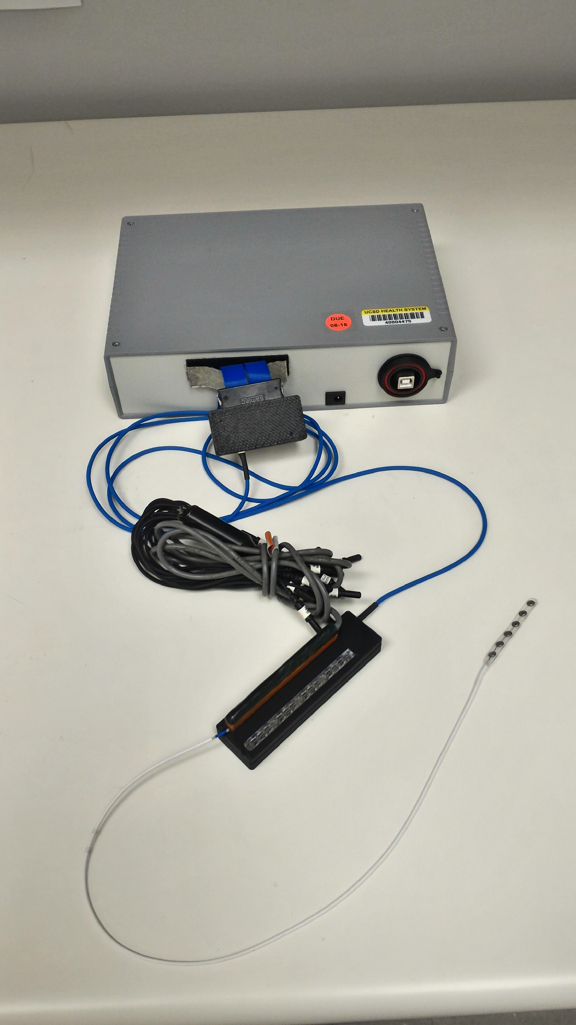
Connecting
1. Intan Cable
4. Clinical Cable
2. Gnd / Ref
Connect blue Intan cable (for research hardware)
Connect Gnd and Ref
Slip pigtail into connector
Ensure it’s properly inserted!
Connect clinical cable (for clinical hardware)
3. Pigtail Cable

Slide 6
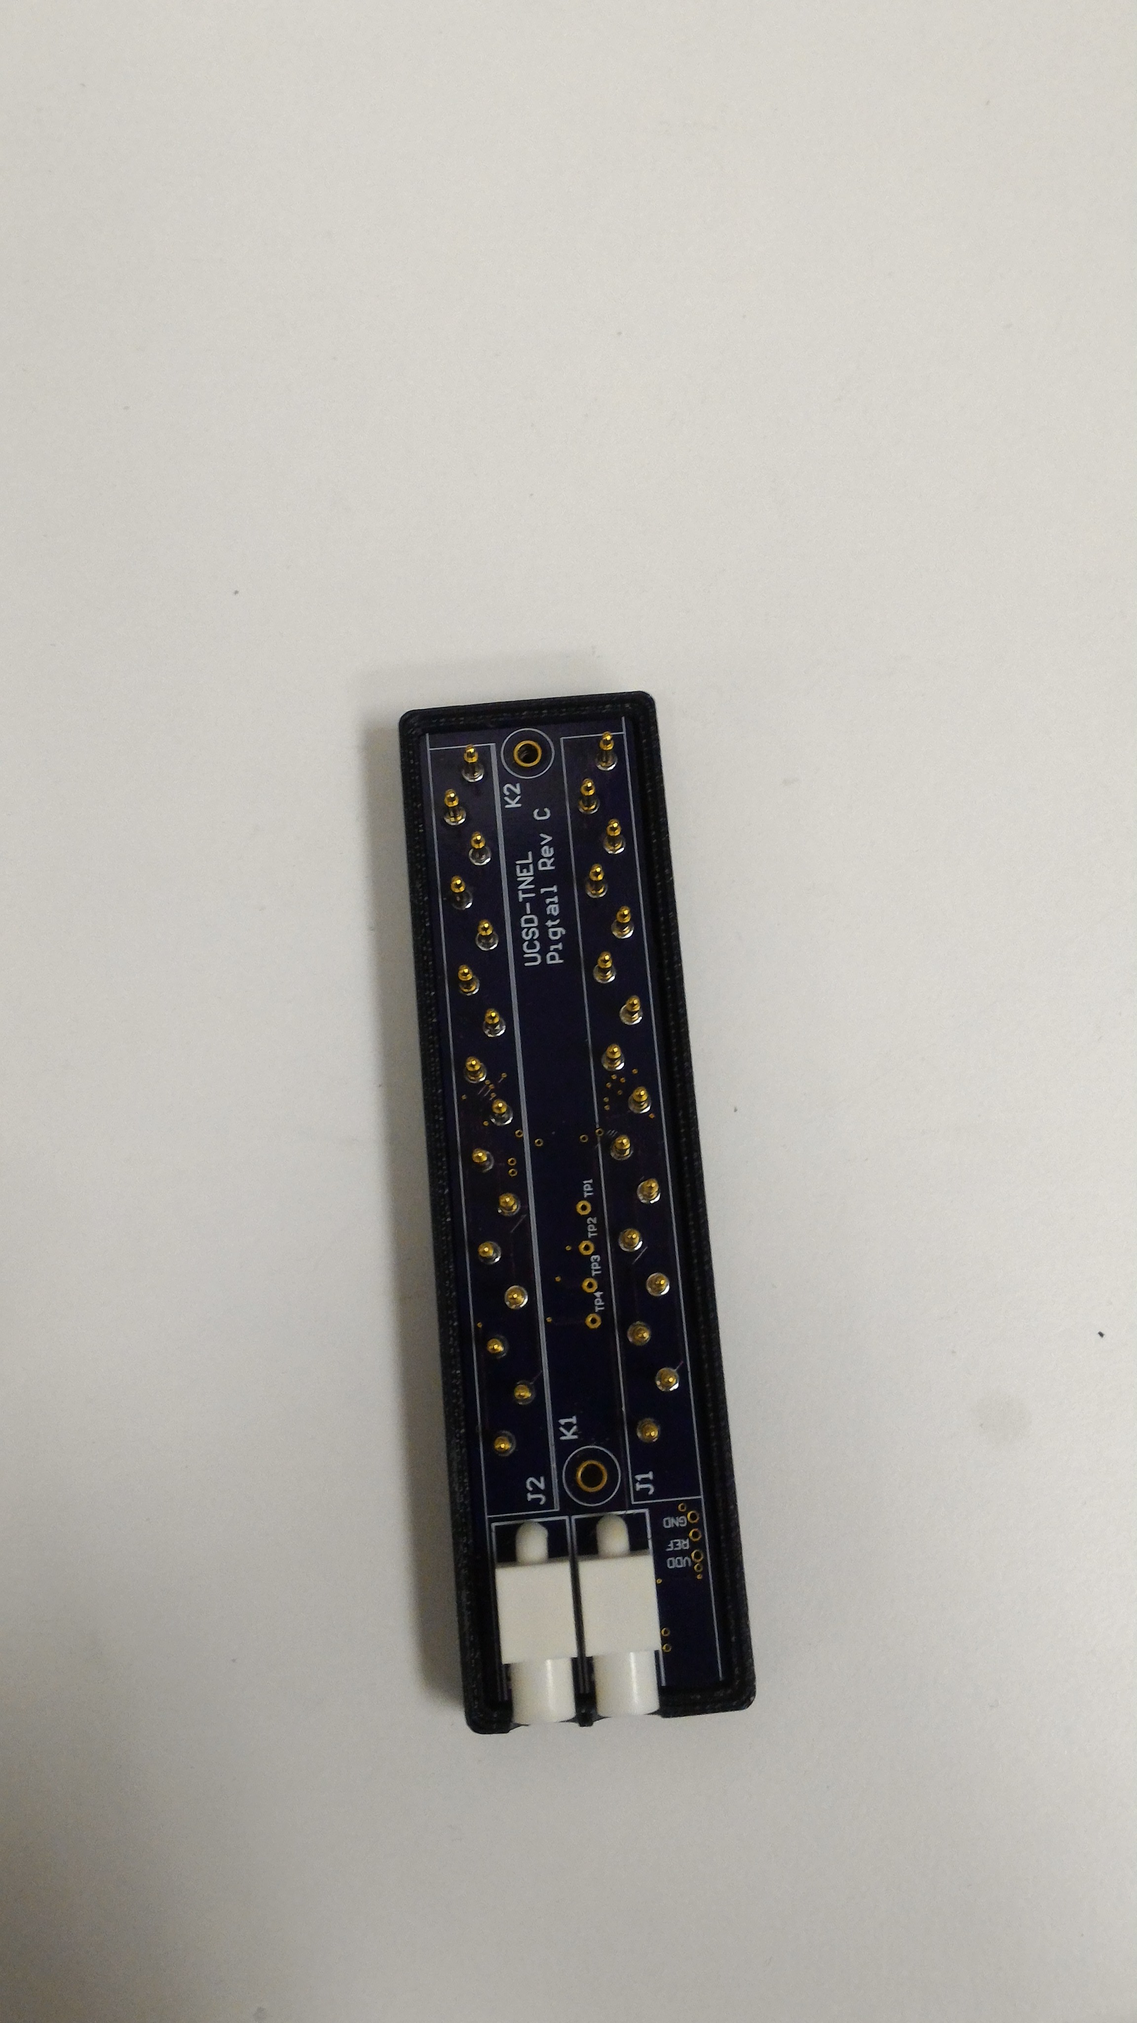
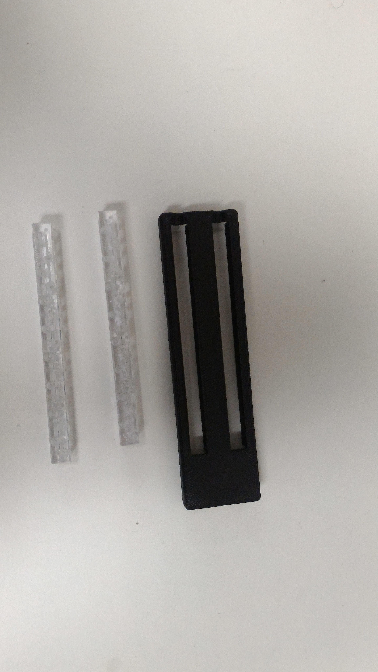
Dis-assemble
WATCH DISASSEMBLE VIDEO
Written Instructions
Remove all connector
Use Philips to remove 2 screws from back
Pull apart back and front of case
Carefully pull away electronics
Remove pigtail connectors by pushing them inwards
Electronics board
Pigtail Connectors can be removed for cleaning or replacement

Slide 7
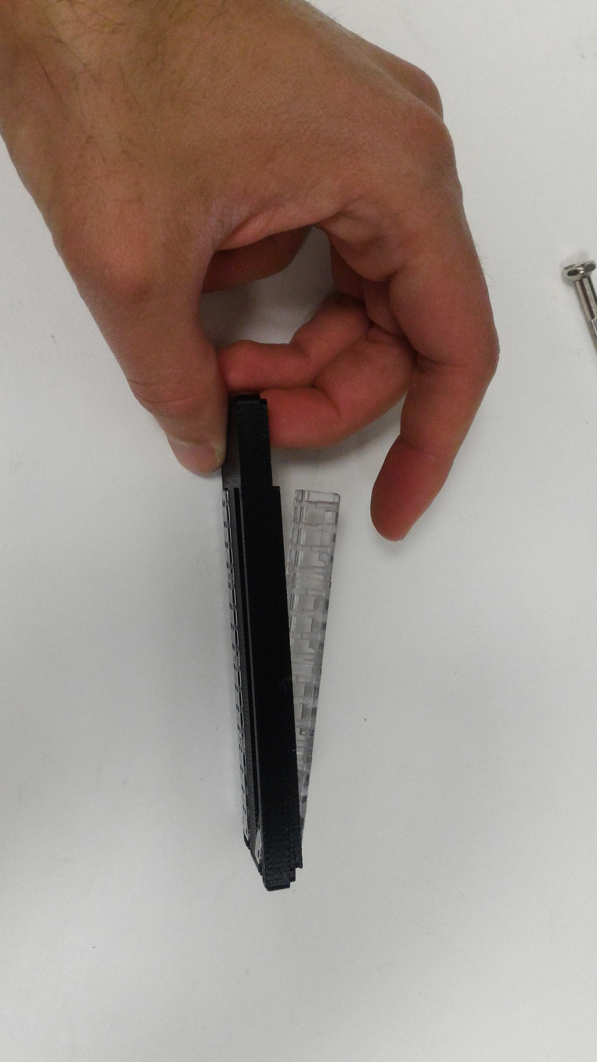
Assemble
WATCH ASSEMBLE VIDEO
Do disassemble instructions in reverse
Push pigtail connector back into place

